Slide 1
A Recommender System for Sports Shop
Applied Data Science Capstone
IBM Data Science Professional Certificate
Summer 2018

Slide 2
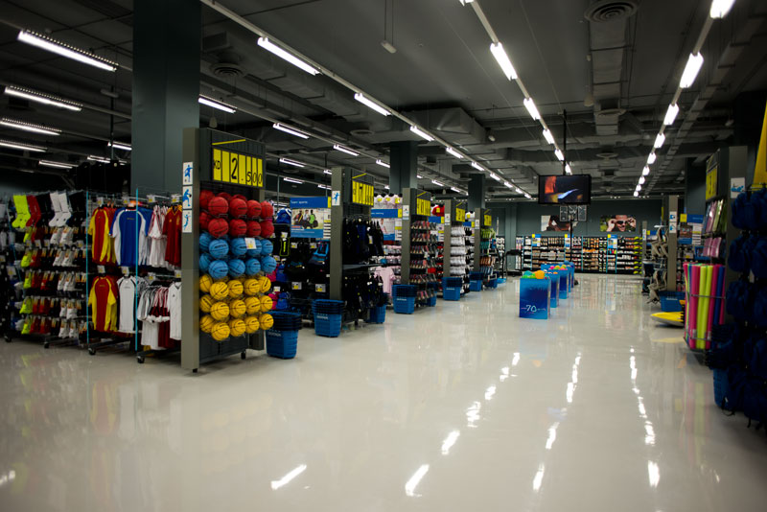
A Recommender System for Sports Shop

Slide 3
PART 1 :- Problem Description
There is a sports goods contractor who is looking to open a sports shop in one of the boroughs of Toronto (North York). This contractor provides sports goods to various gyms , stadiums, playing arenas etc . This contractor is looking to open a new store where he would be able to distribute these goods.
So this analysis will help him to give a deeper look into different neighborhoods in North York and help him decide where to open a new sports shop. Furthermore not only gyms, stadiums but people coming to these places would buy their sports goods from the sports shop.

Slide 4
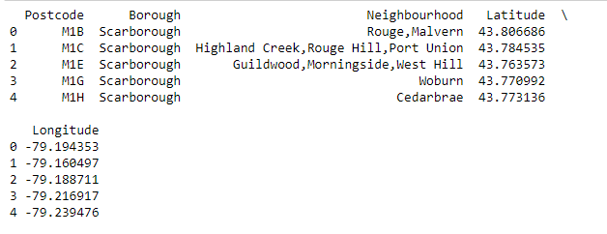
Part 2: Data
We will be getting data as per:
1. Web scraping data from wikipedia of neighborhoods in Toronto.
2. Using Geocoder package to get the latitudes and longitudes.
3. Using FourSquare location to fetch the details of venues nearby.

Slide 5
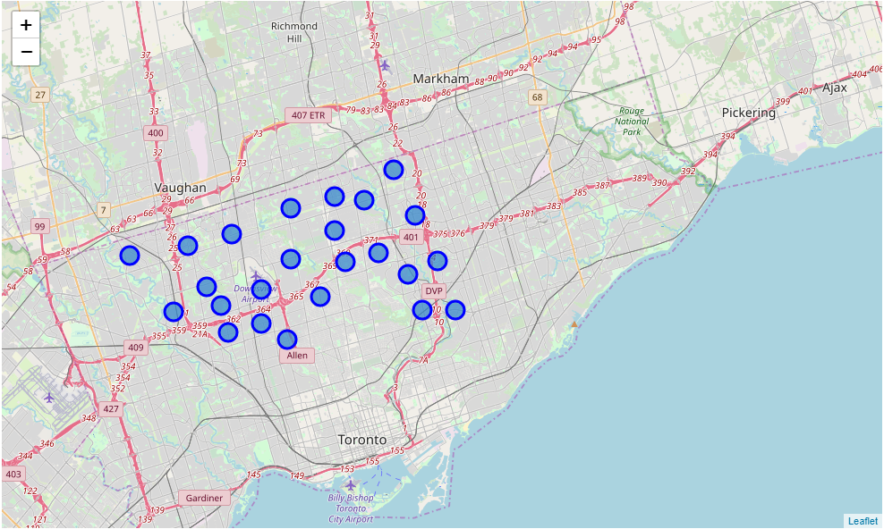
Main Article
Part 1: Identifying Postal Codes (and then Neighborhoods) in “North York”

Slide 6
Main Article
Part 2: Connecting to Foursquare and Retrieving Locational Data for Each Venue in Every Neighborhood
After finding the list of neighborhoods, we then connect to the Foursquare API to gather information about venues inside each and every neighborhood. For each neighborhood, we have chosen the radius to be 1000 meter. It means that we have asked Foursquare to find venues that are at most 1000 meter far from the center of the neighborhood.

Slide 7
Main Article
Part 3: Processing the Retrieved Data and Creating a DataFrame for All the Venues inside the North York
When the data is completely gathered, we will perform processing on that raw data to find our desirable features for each venue. Our main feature is the category of that venue. After this stage, the column "Venue's Category" will be One-hot encoded and different venues will have different feature-columns.
Now, the dataset is fully ready to be used for machine learning (and statistical analysis) purposes.

Slide 8
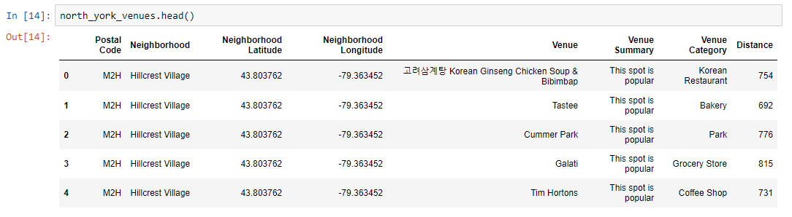
Main Article
Part 3: Processing the Retrieved Data and Creating a DataFrame for All the Venues inside the North York

Slide 9
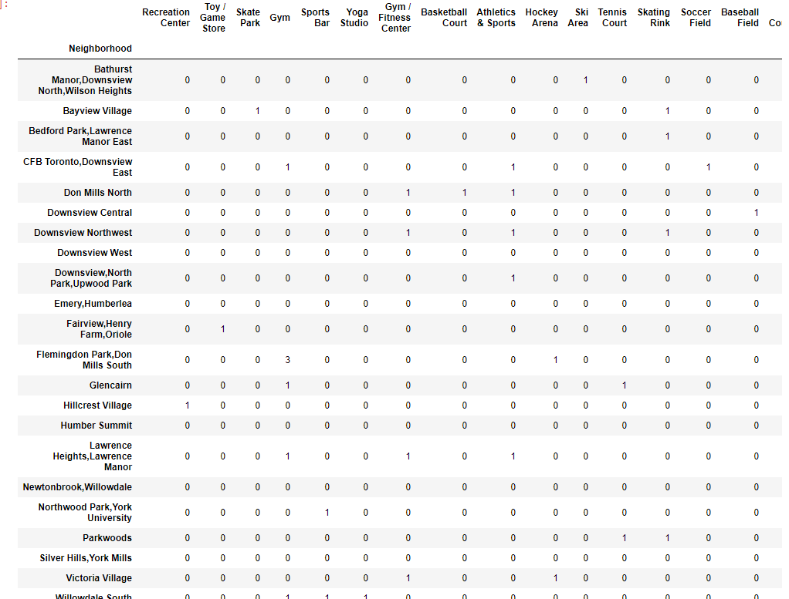
Now, the dataset is fully ready to be used for machine learning (and statistical analysis) purposes.

Slide 10
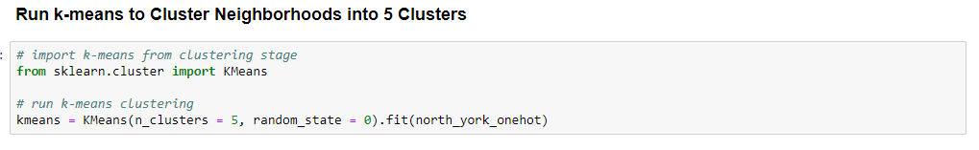
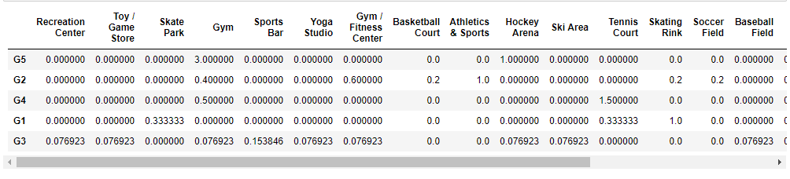
Main Article
Part 4: Applying one of Machine Learning Techniques (K-Means Clustering)

Slide 11
Decision Making and Reporting Results
Now, we focus on the centers of clusters. The group which its center has the highest "Total Sum" will be our best recommendation to the contractor. This algorithm although is pretty straightforward yet is strongly powerful.

Slide 12
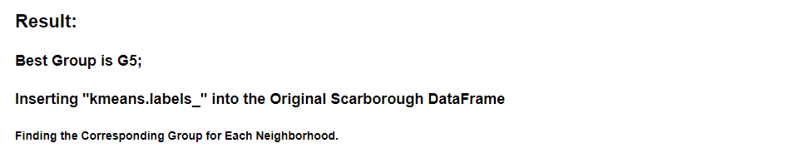
Decision Making and Reporting Results

Slide 13
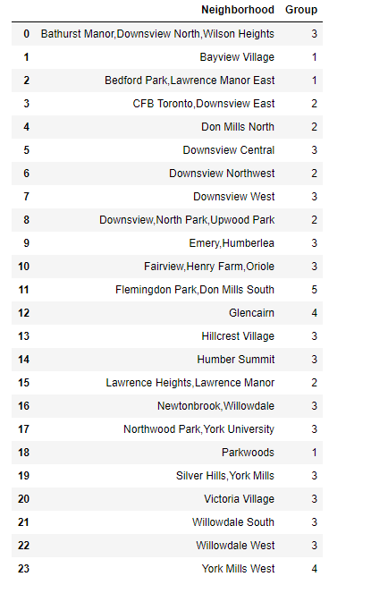
Decision Making and Reporting Results

Slide 14
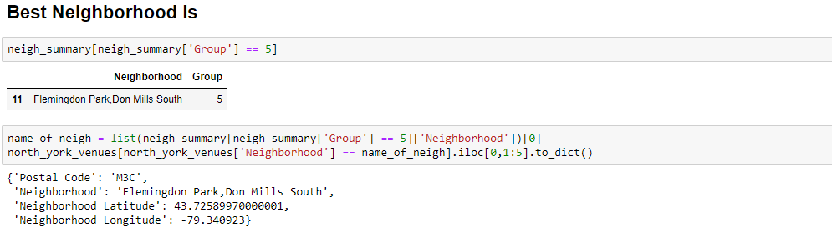
Decision Making and Reporting Results

Slide 15
Thank You

